Slide 1

Internet of Things and Intelligent Communities
Emerging Technology Communities of Interest
May 17, 2022

Slide 2

Agenda
Introduction
NUSCL
IoT Intelligent Communities Leaders
  The new Fed IoT working group and acquiring IoT
  IoT in Energy and Critical Infrastructure
  Digital Twins at an installation
  IoT in a connected world – the synergy of IoT, Blockchain, and AI
Closing Notes

Slide 3

Emerging Technology COI
Mission Statement:
Provide an energetic, collaborative consortium comprised of practitioners in data science, technology, and research, engaged with industry, academia, and public officials and executives focused on emerging and leading technologies which transform public sector capabilities
Current Objectives:
Develop awareness of Blockchain in government through our Blockchain Working Group, expanding the Blockchain Playbook in preparation for two Blockchain Forums this Fall
Expand Cognitive Computing, Artificial Intelligence, Machine Learning and Quantum Technology awareness to develop broadened understanding and usage in government
Continue driving Analytics and Big Data use through improved and continuous technical alignment with government missions to support citizens, improve program delivery, integrate with cybersecurity, migrate to digital transparency, and combat fraud, waste and abuse
Align awareness and training regarding sensors and interactive technologies that transform the IoT into meaningful usage and application in government
Increase DevOps Culture Adoption Across Federal Agencies by providing best practices of “How” agencies can tackle adoption across the agency through focus on Delivering Highest Value Faster

Slide 4

ET COI Leadership Team
Neil Chaudhry – Government Chair
Rob Wuhrman – Government Vice Chair
Todd Hager – Industry Chair
Frederic de Vaulx – Industry Vice Chair
Jackie French – Communications Chair
Julia Begley – Program Chair
Cindy Good – Special Events Chair
Karin O’Leary – Shared Services COI Liaison
Jessica Alfaro – Social Media Chair
Nancy Delanoche – ACT-IAC COI Lead
Jeremy Wood – Government Advisor
Akanksha Sharma – Government Advisor
Sandy Barsky – Industry Advisor
Nevin Taylor – AI Government Chair
Michael Bruce – AI Industry Chair
Joshua Hakakian – Blockchain Government Chair
Fred de Vaulx – Blockchain Industry Chair
George Chenkeli – DevOps Government Chair
David Hernandez – DevOps Industry Chair
Lattrice Goldsby – Intel Auto Government Chair
Brian Jacobs – Intel Auto Industry Chair
Danielle Graham – IoT Government Co-Chair
Mike Berkholtz – IoT Government Co-Chair
Don Lovett – IoT Government Co-Chair
Pete Tseronis – IoT Industry Co-Chair
Jeremy Wood – Quantum KP Government Chair
Tim Gilday – Quantum KP Industry Chair
Follow Us! https://www.linkedin.com/showcase/emerging-technology-coi

Slide 5
NUCSL Highlights
Quick Stats and Information Since Launching on February 22, 2022:
Number of people the NUCSL white paper has been shared with: 10,253
Number of presentations conducted for the NUCSL: 14
Number of people the NUCSL customer journey maps have been shared with: 200+
NUCSL features and information users are most interested in: Emerging Technology Adoption Feasibility, Cross-Agency Collaboration, and Identifying Lessons Learned
Emerging Technology Use Case Organizations Represented in a NUCSL
Department of Homeland Security Procurement Innovation Lab
Internal Revenue Service
National Institute of Standards and Technology
Start-ups and Small, Medium, and Large Businesses
What’s Next!
Artificial Intelligence use case collection in alignment with Executive Order 13960: 21 use cases submitted for Q3
Incubator, Chief Technology Officer, and Chief Data Officer outreach campaigns

Slide 6

We want to hear from you!
Call for volunteers
Reach out at actiacnucsl@gmail.com
Visit the NUCSL site here
User guide available here:

Slide 7
Agenda
Pete Tseronis – IoT in Energy and Critical Infrastructure
Mike Berkholtz – The new Fed IoT working group and Government Use Case
Don Lovett – IoT in a connected world – the synergy of IoT, Blockchain, and AI

Slide 8
IoT Intelligent Community Working Group
Meeting Info:
Our Objective is to provide a forum and content for the sharing and leveraging IoT related technologies across government missions and Intelligent Communities
We meet every other Thursday at 11:00
You are invited to a scheduled Zoom meeting.
https://us06web.zoom.us/j/82468542235?pwd=amlEaDRvWU1SYysvclhMVGQzY2Jjdz09
Meeting ID: 824 6854 2235
Passcode: iot
One tap mobile
+16465588656,,82468542235#,,,,*808816# US (New York)
+13017158592,,82468542235#,,,,*808816# US (Washington DC)
Follow Us! https://www.linkedin.com/showcase/emerging-technology-coi

Slide 9

IoT in a connected world synergy of IoT, Blockchain, and AI
Don Lovett
https://donlovett.github.io/business-card/

Slide 10

Context
Connections and manipulation of experiences in the physical world
Experiences and Assets in the Metaverse or digital world

Slide 11
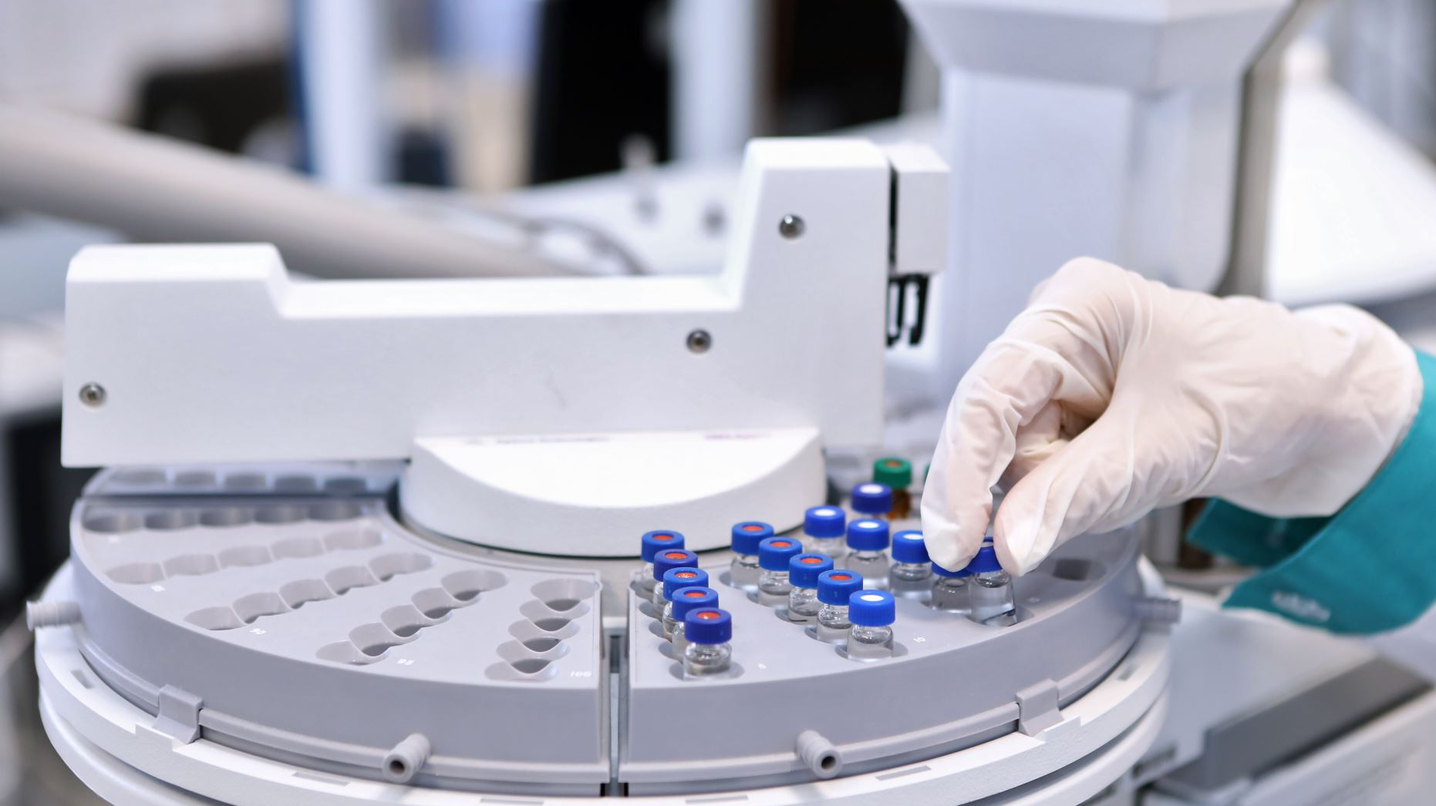
IoT Extends our Senses
A keen vision - Of the five senses, sight is the most widely used in industry. The reason: “This organ is the easiest to study and our biological system is at the same time very fast and very efficient”,
A delicate touch - associating sight with touch where materials indicate in real time if they are damaged in aeronautics.
Fine hearing - In factories, if robots are too sensitive to waves, or if sensors are disturbed in indoor geolocation by too many devices, the alternative is hearing, using ultrasound.
The hollow nose - bad odors in a building, Air quality has become the third major use of IoT sensors in 2021.
A sure taste - an electronic nose used for quality assurance in the food and pharma industries.
https://www.novotaste.com/taste-smell-hearing-iot-takes-on-all-these-senses-the-times-hub/

Slide 12

Web 3.0
It will use technologies like virtual reality (VR) and augmented reality (AR) to draw us in, enabling us to interact with the digital domain in more natural and immersive ways
Web3 concepts – the DAO
The Decentralised Autonomous Organisation (DAO) is a web3 concept describing a group, company or collective that are bound by rules and regulations coded into a blockchain.
Artificial intelligence (AI) and web 3.0
Most people believe that AI will play a big part in web3. This is due to the heavy involvement of machine-to-machine communication and decision-making
How does the metaverse fit with web3?
In relation to web3, the term “metaverse” covers the next iteration of the internet’s front-end – the user interface through which we interact with the online world, communicate with other users, and manipulate data.
https://www.forbes.com/sites/bernardmarr/2022/01/24/what-is-web3-all-about-an-easy-explanation-with-examples/?sh=33a977112255

Slide 13
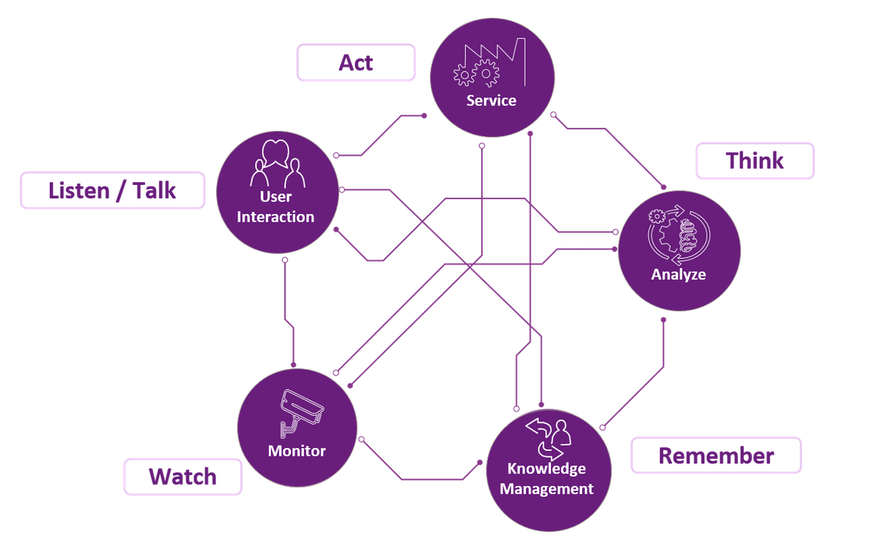
The Five Senses of AI
Christopher Stancombe
Intelligent Automation

Slide 14
Opportunities & Challenges - Why Now?
Challenge | IoT Impact | AI Impact | Blockchain Impact
Too much data to make sense of | H | H
To fast for human analysis | H | H
Precision beyond human capability | H | H | M
Smart Algorithms |  | H
Shared sources of authoritative data | H | M | H
Machine to Machine Communication | H | H | H
Distributed Location of Collection | H |  | H
Human Machine Interfaces | M | M | M
Compliance with Policies and Regulations | L | M | L

Slide 15
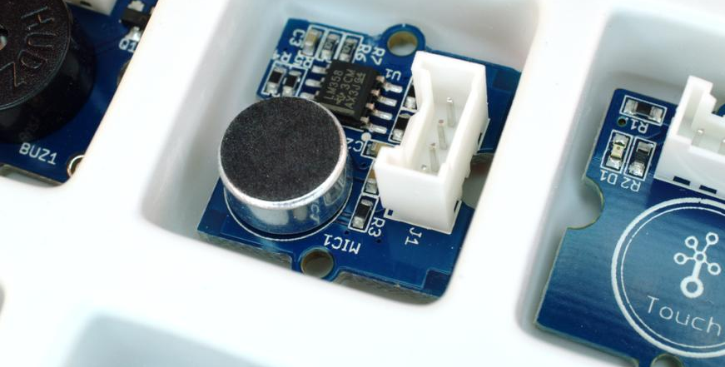

Building Blocks
Sensors
Actuators
31 Billion Devices 1/1/2022

Slide 16
Communication Protocols
Wired
Wireless
LoRaWan
5G
Protocol
TCP-IP v4
TCP-IP v6
Trusted
Zero Trust

Slide 17
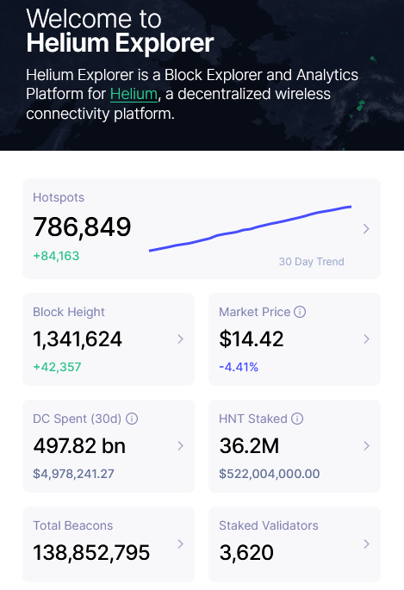
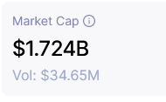

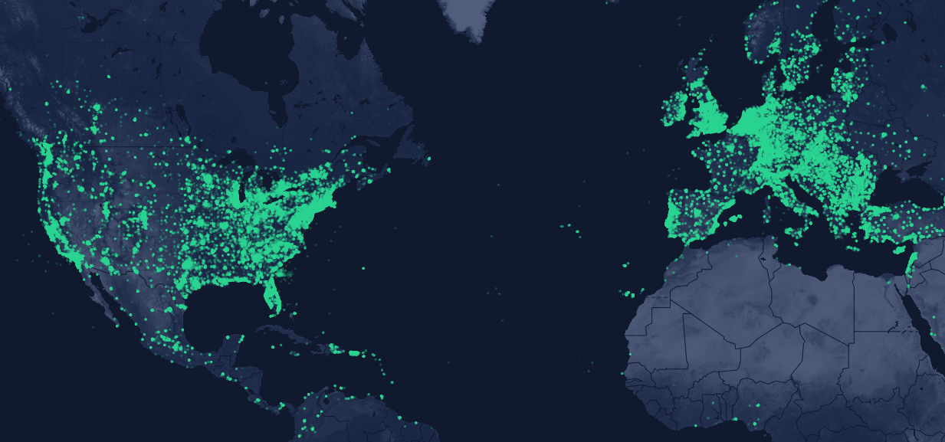
IoT meet Blockchain – Economics in Helium
https://explorer.helium.com/

Slide 18
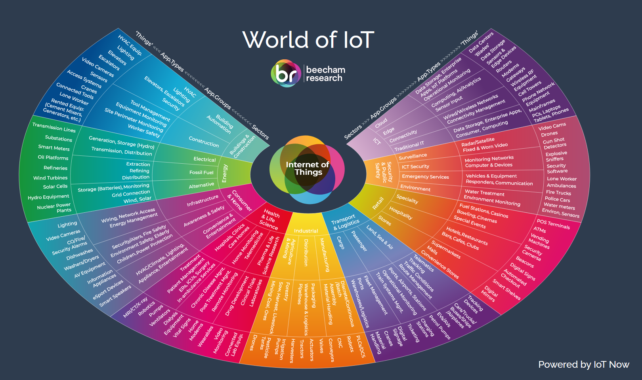
Applications
https://www.iot-now.com/world-of-iot/

Slide 19

Algorithmic Accountability
In their paper, “Algorithmic Impact Assessments under the GDPR: Producing Multi-layered Explanations”, Professor Kaminski and Mr. Malgieri explore how a Data Protection Impact Assessment (DPIA) links the two faces of the GDPR’s approach to algorithmic accountability: individual rights and systemic collaborative governance.
Image: https://www.bangkokpost.com/business/1978091/artificial-intelligence-how-realistic-is-the-claim-that-ai-will-change-our-lives-

Slide 20
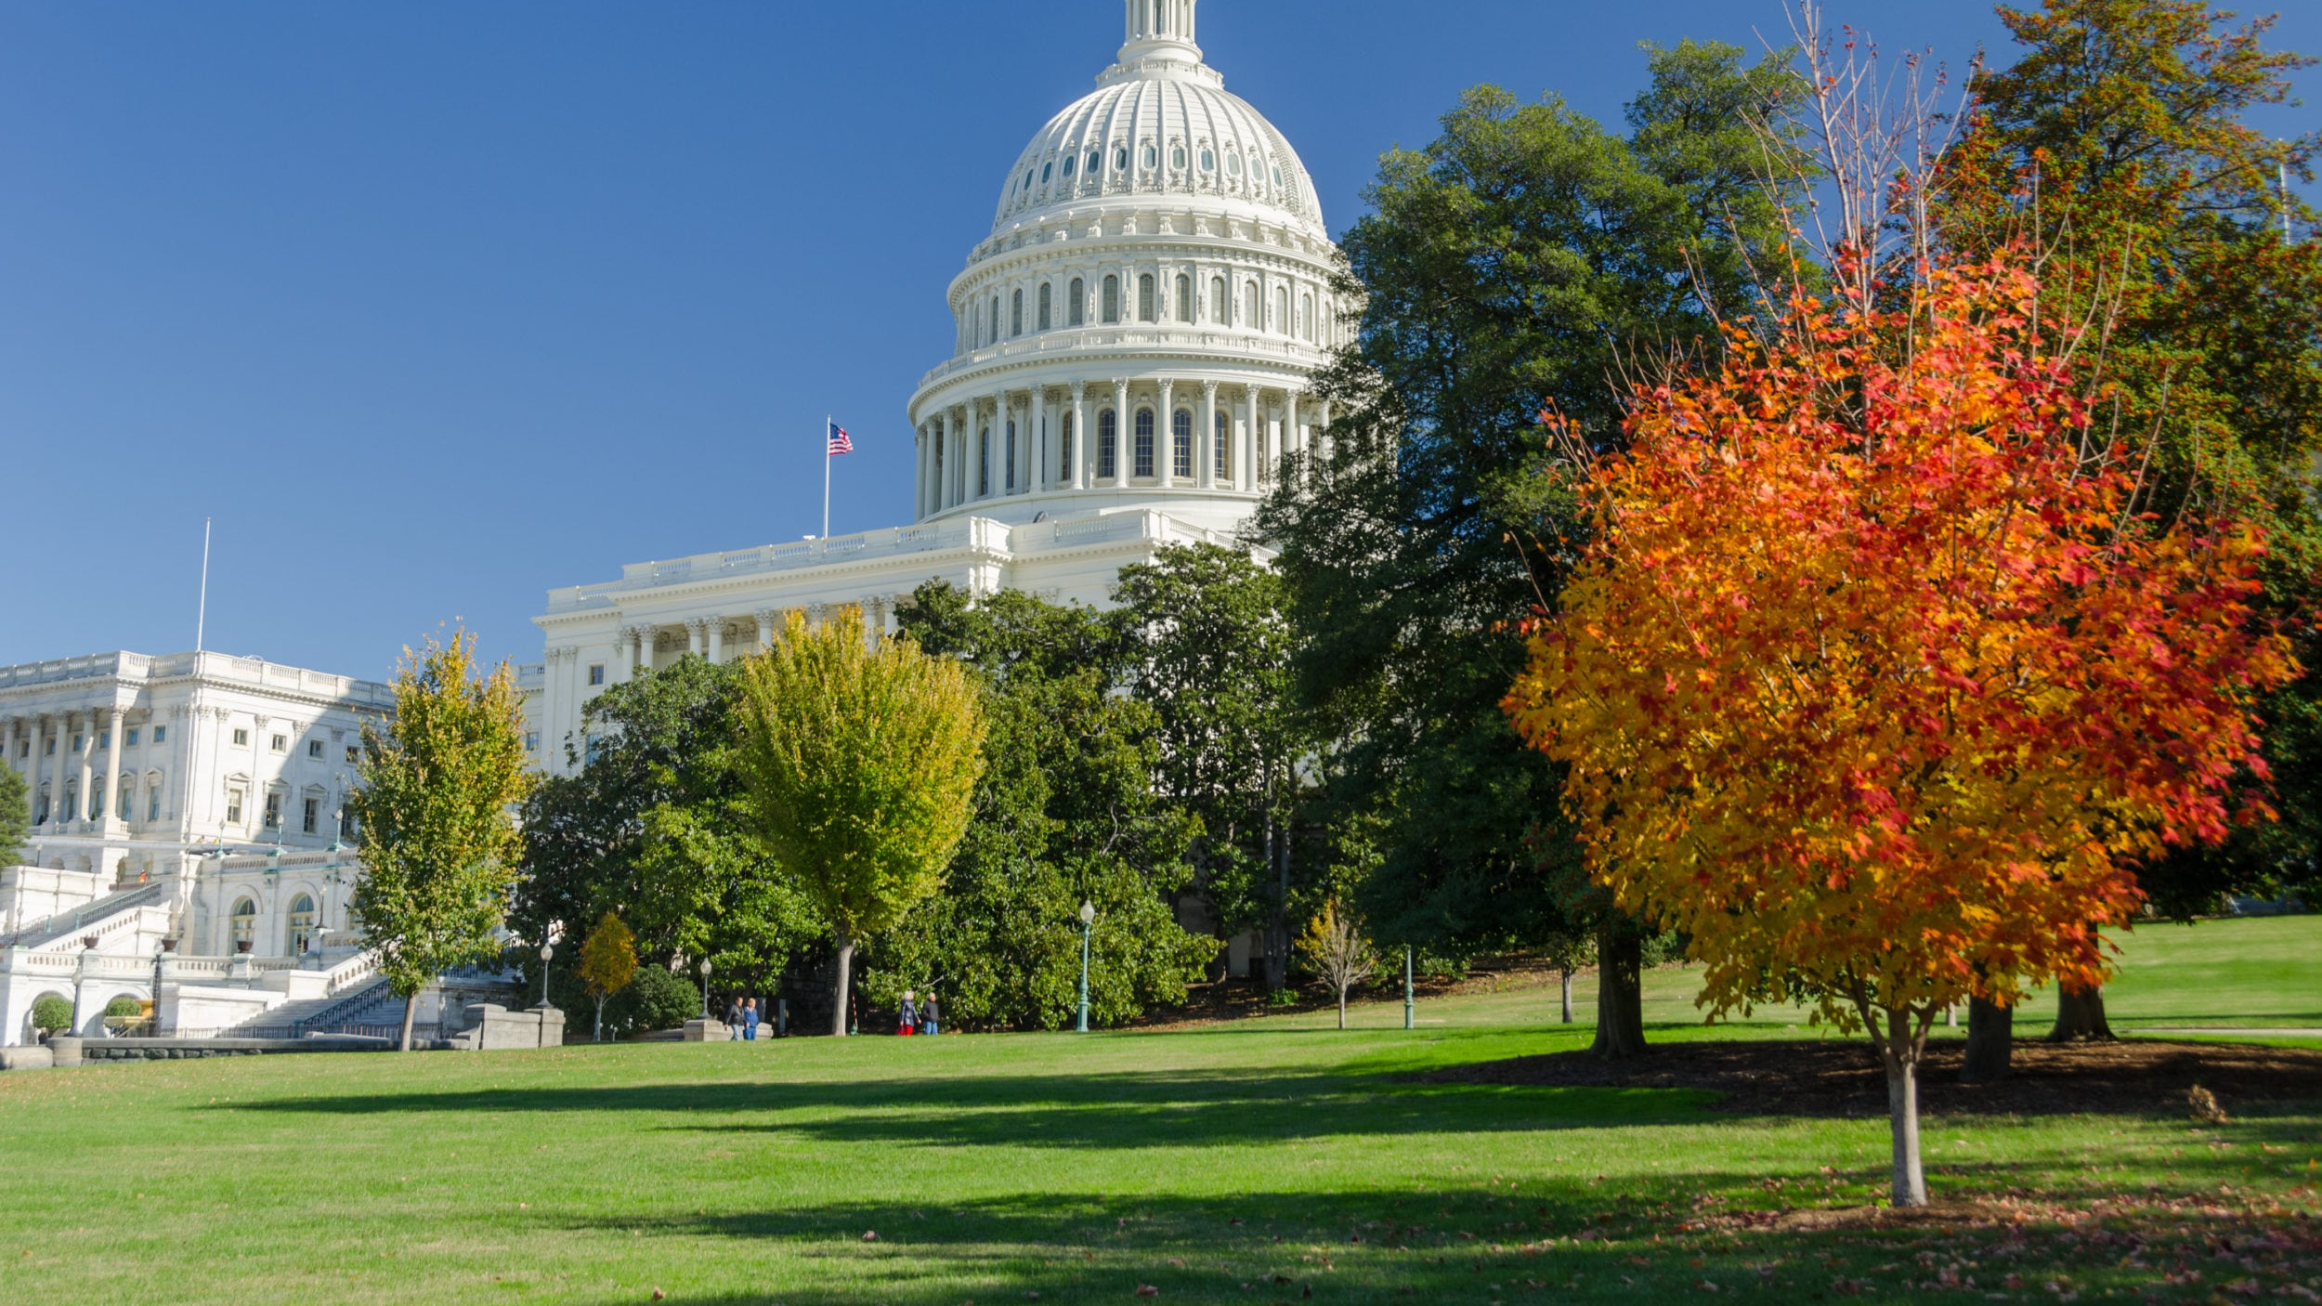
Four Key Policy Goals
1. Respect the public’s right to know which systems impact their lives by publicly listing and describing automated decision systems that significantly affect individuals and communities
2. Increase public agencies’ internal expertise and capacity to evaluate the systems they build or procure, so they can anticipate issues that might raise concerns, such as disparate impacts or due process violations
3. Ensure greater accountability of automated decision systems by providing a meaningful and ongoing opportunity for external researchers to review, audit, and assess these systems using methods that allow them to identify and detect problems
4. Ensure that the public has a meaningful opportunity to respond to and, if necessary, dispute the use of a given system or an agency’s approach to algorithmic accountability
https://ainowinstitute.org/aiareport2018.pdf

Slide 21


Workforce Preparation - MIT Course
Digital Transformation: From AI and IoT to Cloud, Blockchain, and Cybersecurity
Participant Takeaways
User the MetaMask plugin to conduct transactions with Ether, a cryptocurrency
Deploy a simple contract to the Etherium blockchain
Create a repository in GitHub, a platform for managing software development
Create your own webpage on a custom domain and set up the Cloud server
Demonstration of how machine learning algorithms can help make decisions involving incomplete and complex data
Discussion of how IoT can be applied to the supply chain
https://professional.mit.edu/course-catalog/digital-transformation-ai-and-iot-cloud-blockchain-and-cybersecurity
Online - 6 Weeks $2,900

Slide 22

Blockchain adds Trust to AI and IoT
Blockchain is at the nexus of technologies like IoT, AI and Cloud. It has the means of bringing the missing element of trust that is currently lacking from these technologies. Trust is gained through diversity of users.
Unlike a database that has a single administrator, a blockchain enables a set of diverse administrators to “referee” the data, such that no single admin can maliciously or accidentally change or delete data. And once the administrators reach consensus, the data is secured in blocks that are “chained” to one another cryptographically forming a tamper resistant ledger.
When AI, IoT and Cloud use blockchain to track provenance, proofs and permissions associated with data used and emanating from these systems, the trust in the data is increased radically.
https://www.ibm.com/blogs/blockchain/2020/08/how-blockchain-adds-trust-to-ai-and-iot/

Slide 23

A Turning Point
By 2025 it is expected that there will be around 55.7 billion connected devices which will influence the lives of the global population daily. The scale of these connected devices – and the rate they are growing – will continue to shape our present and our future.
Underpinning this wholly connected world is the Internet of Things (IoT), and it is poised to have an impact on the decade ahead few would have ever imagined. We have moved beyond the stage of early adopters towards the metaverse, a truly digital-first decade in which interactions with the physical world are primarily digital.
The challenge of IoT security is sharply coming into focus and the World Economic Forum now lists cybersecurity failure as a critical threat in the next two years.

Slide 24
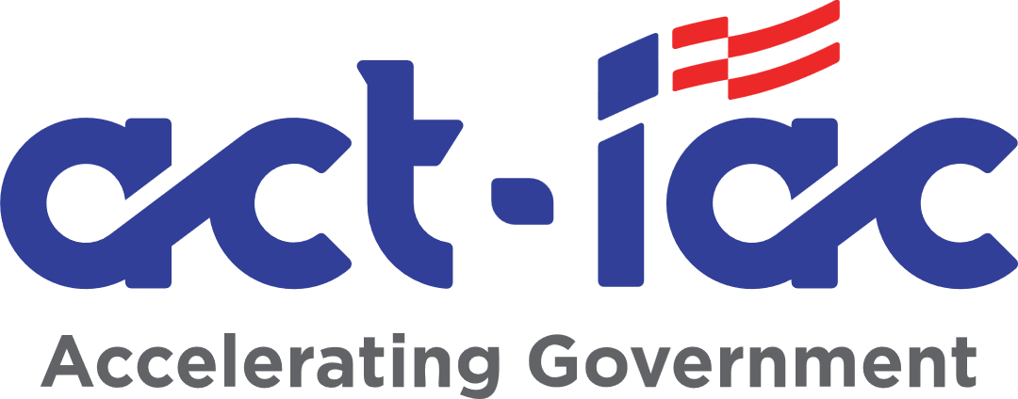

Sample of Working Group Publications
Blockchain Primer
https://www.actiac.org/documents/blockchain-primer
Ethical Application of AI Framework
https://www.actiac.org/documents/act-iac-white-paper-ethical-application-ai-framework

Slide 25

Government Blockchain Association (GBA) has recently published the Blockchain Maturity Model (BMM)
Blockchain and Sustainable Economic Growth conference on May 25–27 in Washington, DC https://gbaglobal.org/blockchain-sustainable-economic-growth/
The model describes eleven characteristics that should be considered in evaluating any blockchain solution. They are:
Distribution
Governance
Identity Management
Interoperability
Performance
Privacy
Reliability
Resilience (Fault Tolerance)
Security
Infrastructure Sustainability
Synchronization

Slide 26
Wrap-up

Slide 27

ET Wrap-up
Meeting Cadence
Next meeting scheduled for Tuesday, June 16th from 10 – 11:30am
Working Title: How HCD and CX is Driving Cybersecurity Frameworks and Technologies
Ongoing
ET Working Groups
  Blockchain Working Group – Fridays 10-11am (Joshua Hakakian joshua.hakakian@va.gov)
  AI Working Group – Fridays 11-12pm (Joshua Hakakian joshua.hakakian@va.gov)
  Intelligent Automation Working Group – (Brian Jacobs bjacobs@macrosolutions.com)
  IoT Working Group – Thursdays 8:30am (Don Lovett don@projectbits.com)
  DevOps Working Group – (David Hernandez dhernandez@yext.com11)
  Quantum Knowledge Group – (Tim Gilday tim.gilday@gdit.com)

Slide 28
Thank you
Follow Us! https://www.linkedin.com/showcase/emerging-technology-coi

